Slide 1
QSYS - He Recovery Scenarios
ACR Unit

Slide 2
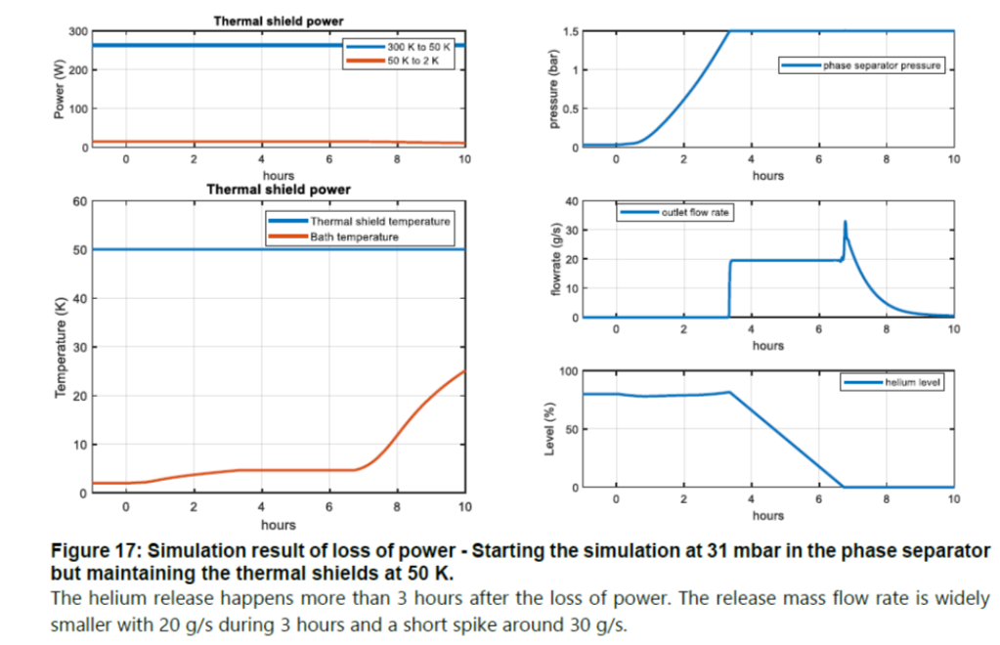
Header S – Safety Header
S is a safety header
Protects the linac headers, and the user equipment
Accepts cold helium; clean helium only
Not to be confused with normal/abnormal operation, where header B can be kept below 2bar
This is accomplished via PVPS or compressors
This is an operation requirement; pumping header B is not a safety scenario
Header S shall cover as many safety scenarios as possible
Known exceptions where S is not sufficient
“Loss of BVAC” uses the BDs to vent to V
“Loss of INVAC” may be just a borderline case. TBC
Pressure on Header S is ensured by SV & BD towards V
BD on header S has a different function than BD on the user.
The BD on the users are only triggered for safety cases where header S is not responsible (i.e. BVAC loss)
The BD on header S ensures its pressure in the case that helium recovery is too slow
DN150 (max 100 g/s; reliable* for 40g/s)
S
WCS
SV
QRB
QLM
QCELLs
QVE
* In case of mayor disruptions, it shall possible to restart “key systems” within 20-30min to discharge 40g/s from header S to GHe storage.
Header S to be sized for
natural reheating of the Linac
→ 20 g/s + spike at 30 g/s

Slide 3
Header S – Safety Header
QPLANT full green
QPLANT minimal green
Case 1
S
S
Recovery via B
WCS
SV
WCS
SV
B
QRB
QLM
QCELLs
QVE
B
QRB
QLM
QCELLs
QVE
Case 2
S
S
Recovery via S
WCS
SV
WCS
SV
QRB
QLM
QCELLs
QVE
QRB
QLM
QCELLs
QVE

Slide 4
Header S – Safety Header
QPLANT full green
QPLANT minimal green
Case 1
HP
Other
Recovery via B
LP
VLP
D-E
A-B
WCS
WCS
CC
QRB
QRB
QLM
QCELLs
QVE
B
m_rec
SV
B and/or S
S
Case 2
S
S
Recovery via S
WCS
SV
WCS
SV
QRB
QLM
QCELLs
QVE
QRB
QLM
QCELLs
QVE

Slide 5
Header S – Safety Header
QPLANT full green
QPLANT minimal green
Case 1
WCS
Recovery via B
QRB
WCS
m_rec
QRB
QLM
QCELLs
QVE
B
2bara
B and/or S
SV
CV
CV
BD vents, sized for loss of BVAC
S
SV, passive, protects the burst discs, sized for 90% issues
(Loss of INVAC, QPLANT off)
CV, control system, to limit p fluctuations
(Normally closed)
[sized for 2-3g/s at fully open]
Case 1
1.15-1.20bara
WCS
1.25? bara
4K operation
QRB
QLM
QCELLs
QVE
B
dp at QRB HX (around 200mbar)
SV
SV
CV
1.05 bara
LP suction
S
1.05 bara
1.1-1.5 bara
1.7 bara

Slide 6
Header S – Safety Header
QPLANT full green
QPLANT minimal green
WCS
HP
PVPS
ORS
Dryers
QRB
HT half
LT half
CC
Warm
HP
ORS
Recovery via B
LP
VLP
D-E
A-B
WCS
CC
QRB
QLM
QCELLs
QVE
B
m_rec
SV
S
B and/or S
Case 2
S
S
Recovery via S
WCS
SV
WCS
SV
QRB
QLM
QCELLs
QVE
QRB
QLM
QCELLs
QVE

Slide 7
DSBT D2.1
When do we need/trigger He Recovery
This can be planned or unplanned events
Scenario A) planned, normal scenario
A1) During QCELL emptying of the LHe inventory
Scenario B) unplanned, abnormal scenario
B1) Trip of QPLANT Cold Compressors only
B2) Trip of QPLANT in general; not just Cold Compressors
B3) QCELL valves missbehaiving so that circuit A'-B' pressurizes
Scenario C) unplanned, utility issues
C1) Loss of Water on WCS
C2) Loss of electricity on WCS
C3) Loss of electricity QPLANT wide
Scenario C) unplanned, safety scenario
C1) safety incident causes pressurization of circuit A'-B' [loss of INVAC or BVAC]
C2) safety incident causes pressurization of QRB circuits
Constraints of 4K operation ATS-1869
Green = QPLANT’s He Recovery path is happy
Orange = QPLANT’s He Recovery path is down, but can be restarted
Red =
Case 1

Slide 8
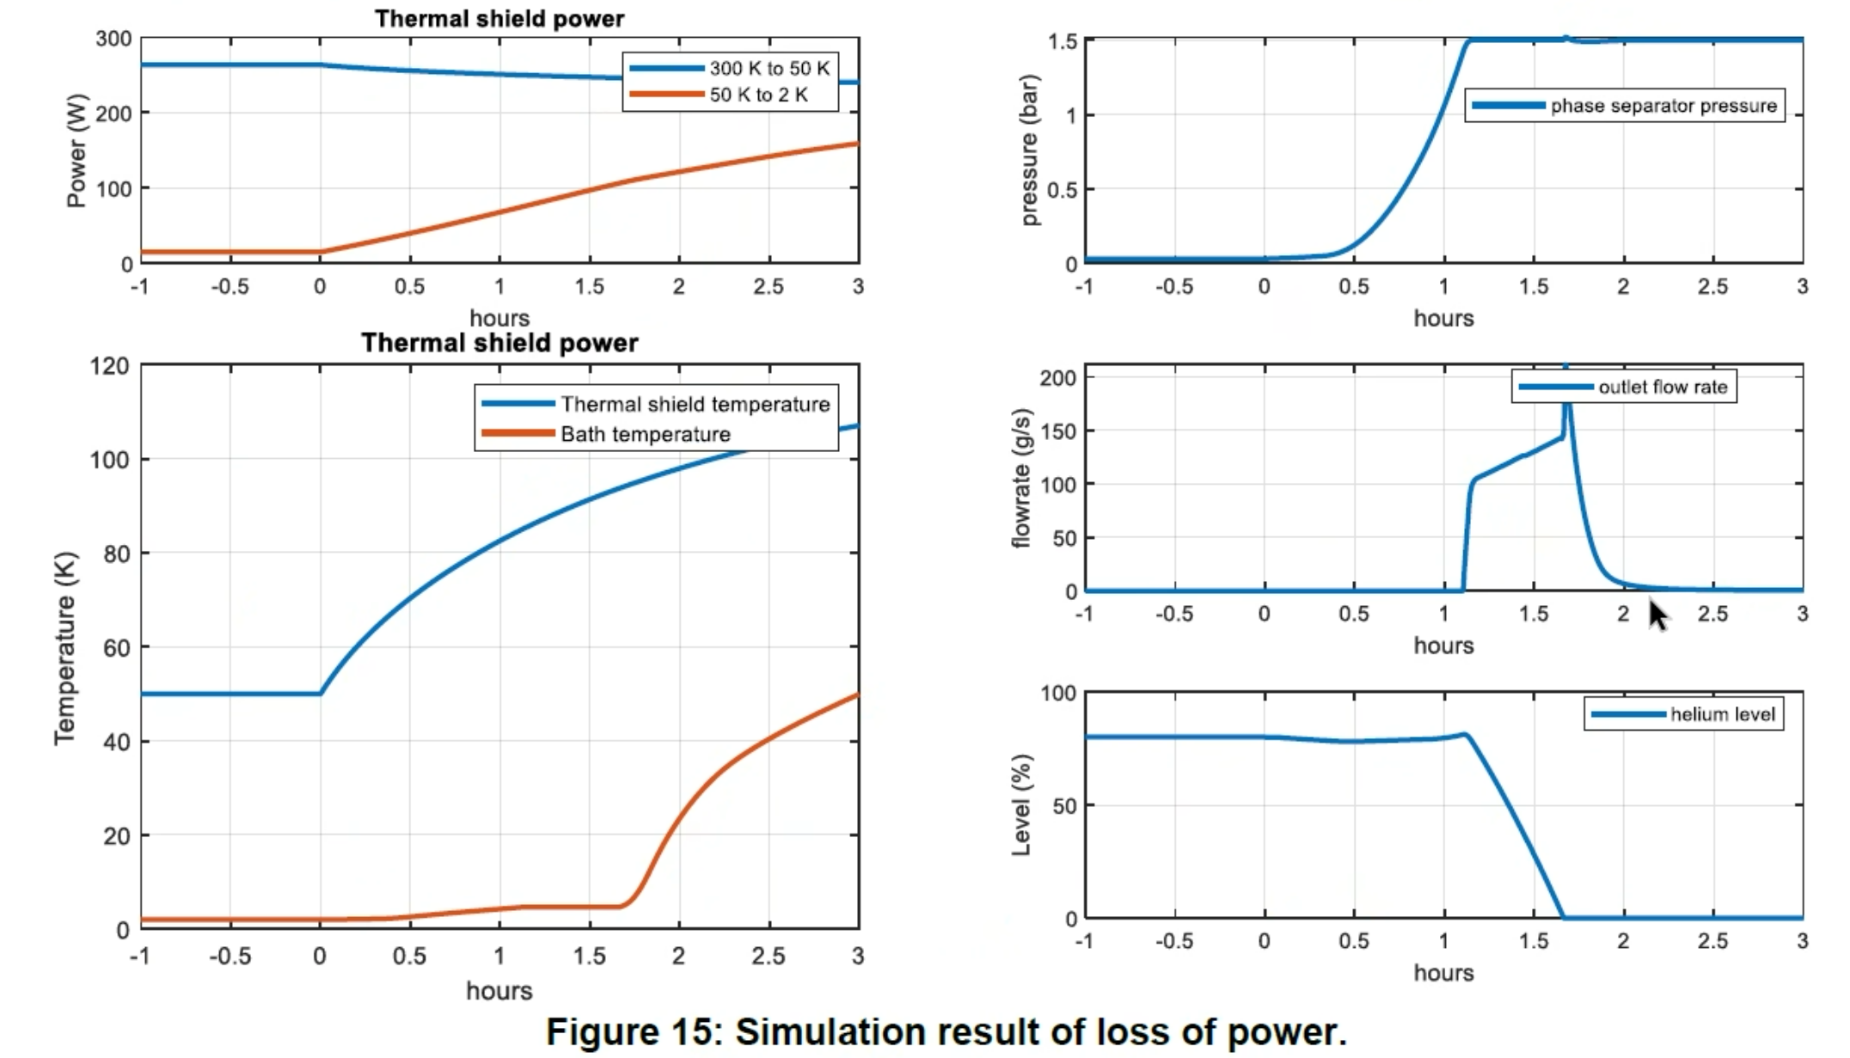
DSBT D2.1
! Start during “2K operation”
! Start during “4K operation”

Slide 9
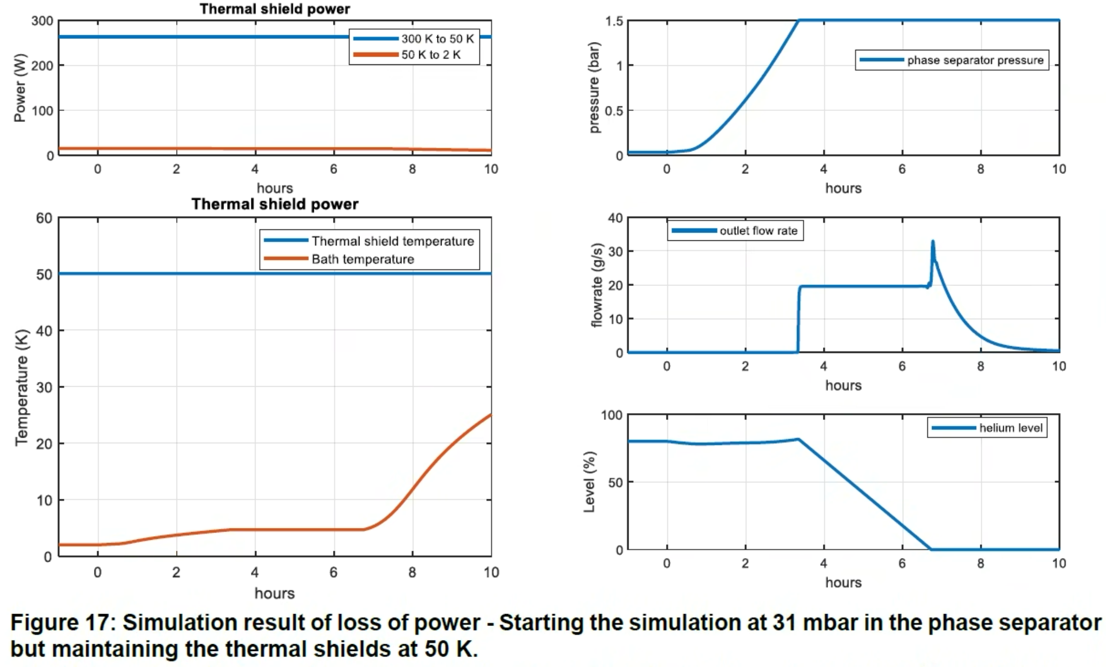
DSBT D2.1

Slide 10
1 Warm Compressor
350 kW
110 g/s
72 Hz
1-15 bara
Below some back of the envelope estimations
LHe inside the LINAC during operation:
900L (= 24QM * 90L + 160L for QVE)
This is around 110 kg
Ballon sizing
1 Kg of GHe at 1bar = 5.5 m3
110 kg is 600 m3
Each of QPLANT Warm Compressor (we will have 3-4)
Rated at 350 kW elec power for 110 g/s [at 72Hz, not 60Hz]
Compress from 1bar to 15bar (pressure of our storage tanks)
In case of incident during black out
recovery needs around 100-200 g/s when the full QPLANT is off [see screenshot below from DSBT estimates]
if linac was at 2K, then start up of recovery needed after 1h
if linac was at 4K-standby, then start up is already within 15min!
recovery flow rate drops to 20-40 g/s if QPLANT is still partially under operation (thermal shield cooling still OK)
Machine protection
Safety devices protects the linac against overpressure. Release pressure is slightly lower than 2bar.
In this scenario we gradually vent the He inventory to ambient via safety valves. No burst discs will be triggered during this event.

Slide 11
Copyright © SCK CEN
All property rights and copyright are reserved.
This presentation contains data, information and formats for dedicated use only and may not be communicated, copied, reproduced, distributed or cited without the explicit written permission of SCK CEN.
If this explicit written permission has been obtained, please reference the author, followed by ‘by courtesy of SCK CEN’.
Any infringement to this rule is illegal and entitles to claim damages from the infringer, without prejudice to any other right in case of granting a patent or registration in the field of intellectual property.
SCK CEN
Belgian Nuclear Research Centre
Studiecentrum voor Kernenergie
Centre d'Etude de l'Energie Nucléaire
Foundation of Public Utility
Stichting van Openbaar Nut
Fondation d'Utilité Publique
Registered Office:
Avenue Herrmann-Debrouxlaan 40 - 1160 BRUSSELS - Belgium
Research Centres:
Boeretang 200 - 2400 MOL - Belgium
Chemin du Cyclotron 6 - 1348 Ottignies-Louvain-la-Neuve - Belgium

Slide 12
Header S – Safety Header
QPLANT full green
QPLANT minimal green
Case 1
HP
Other
Recovery via B
LP
VLP
D-E
A-B
WCS
WCS
CC
QRB
QRB
QLM
QCELLs
QVE
B
m_rec
SV
B and/or S
S
Case 2
S
S
Recovery via S
WCS
SV
WCS
SV
QRB
QLM
QCELLs
QVE
QRB
QLM
QCELLs
QVE

Slide 13
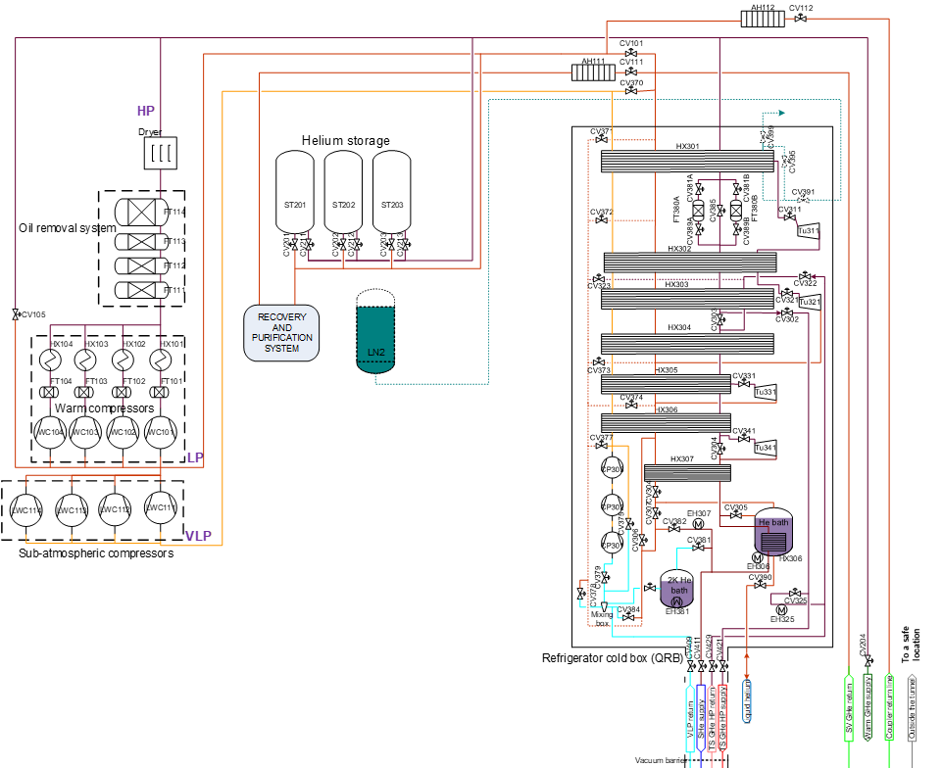
MINERVA Cryoplant [~3.5 kW@4.5 K, of which ~900 W@2 K]

Slide 14
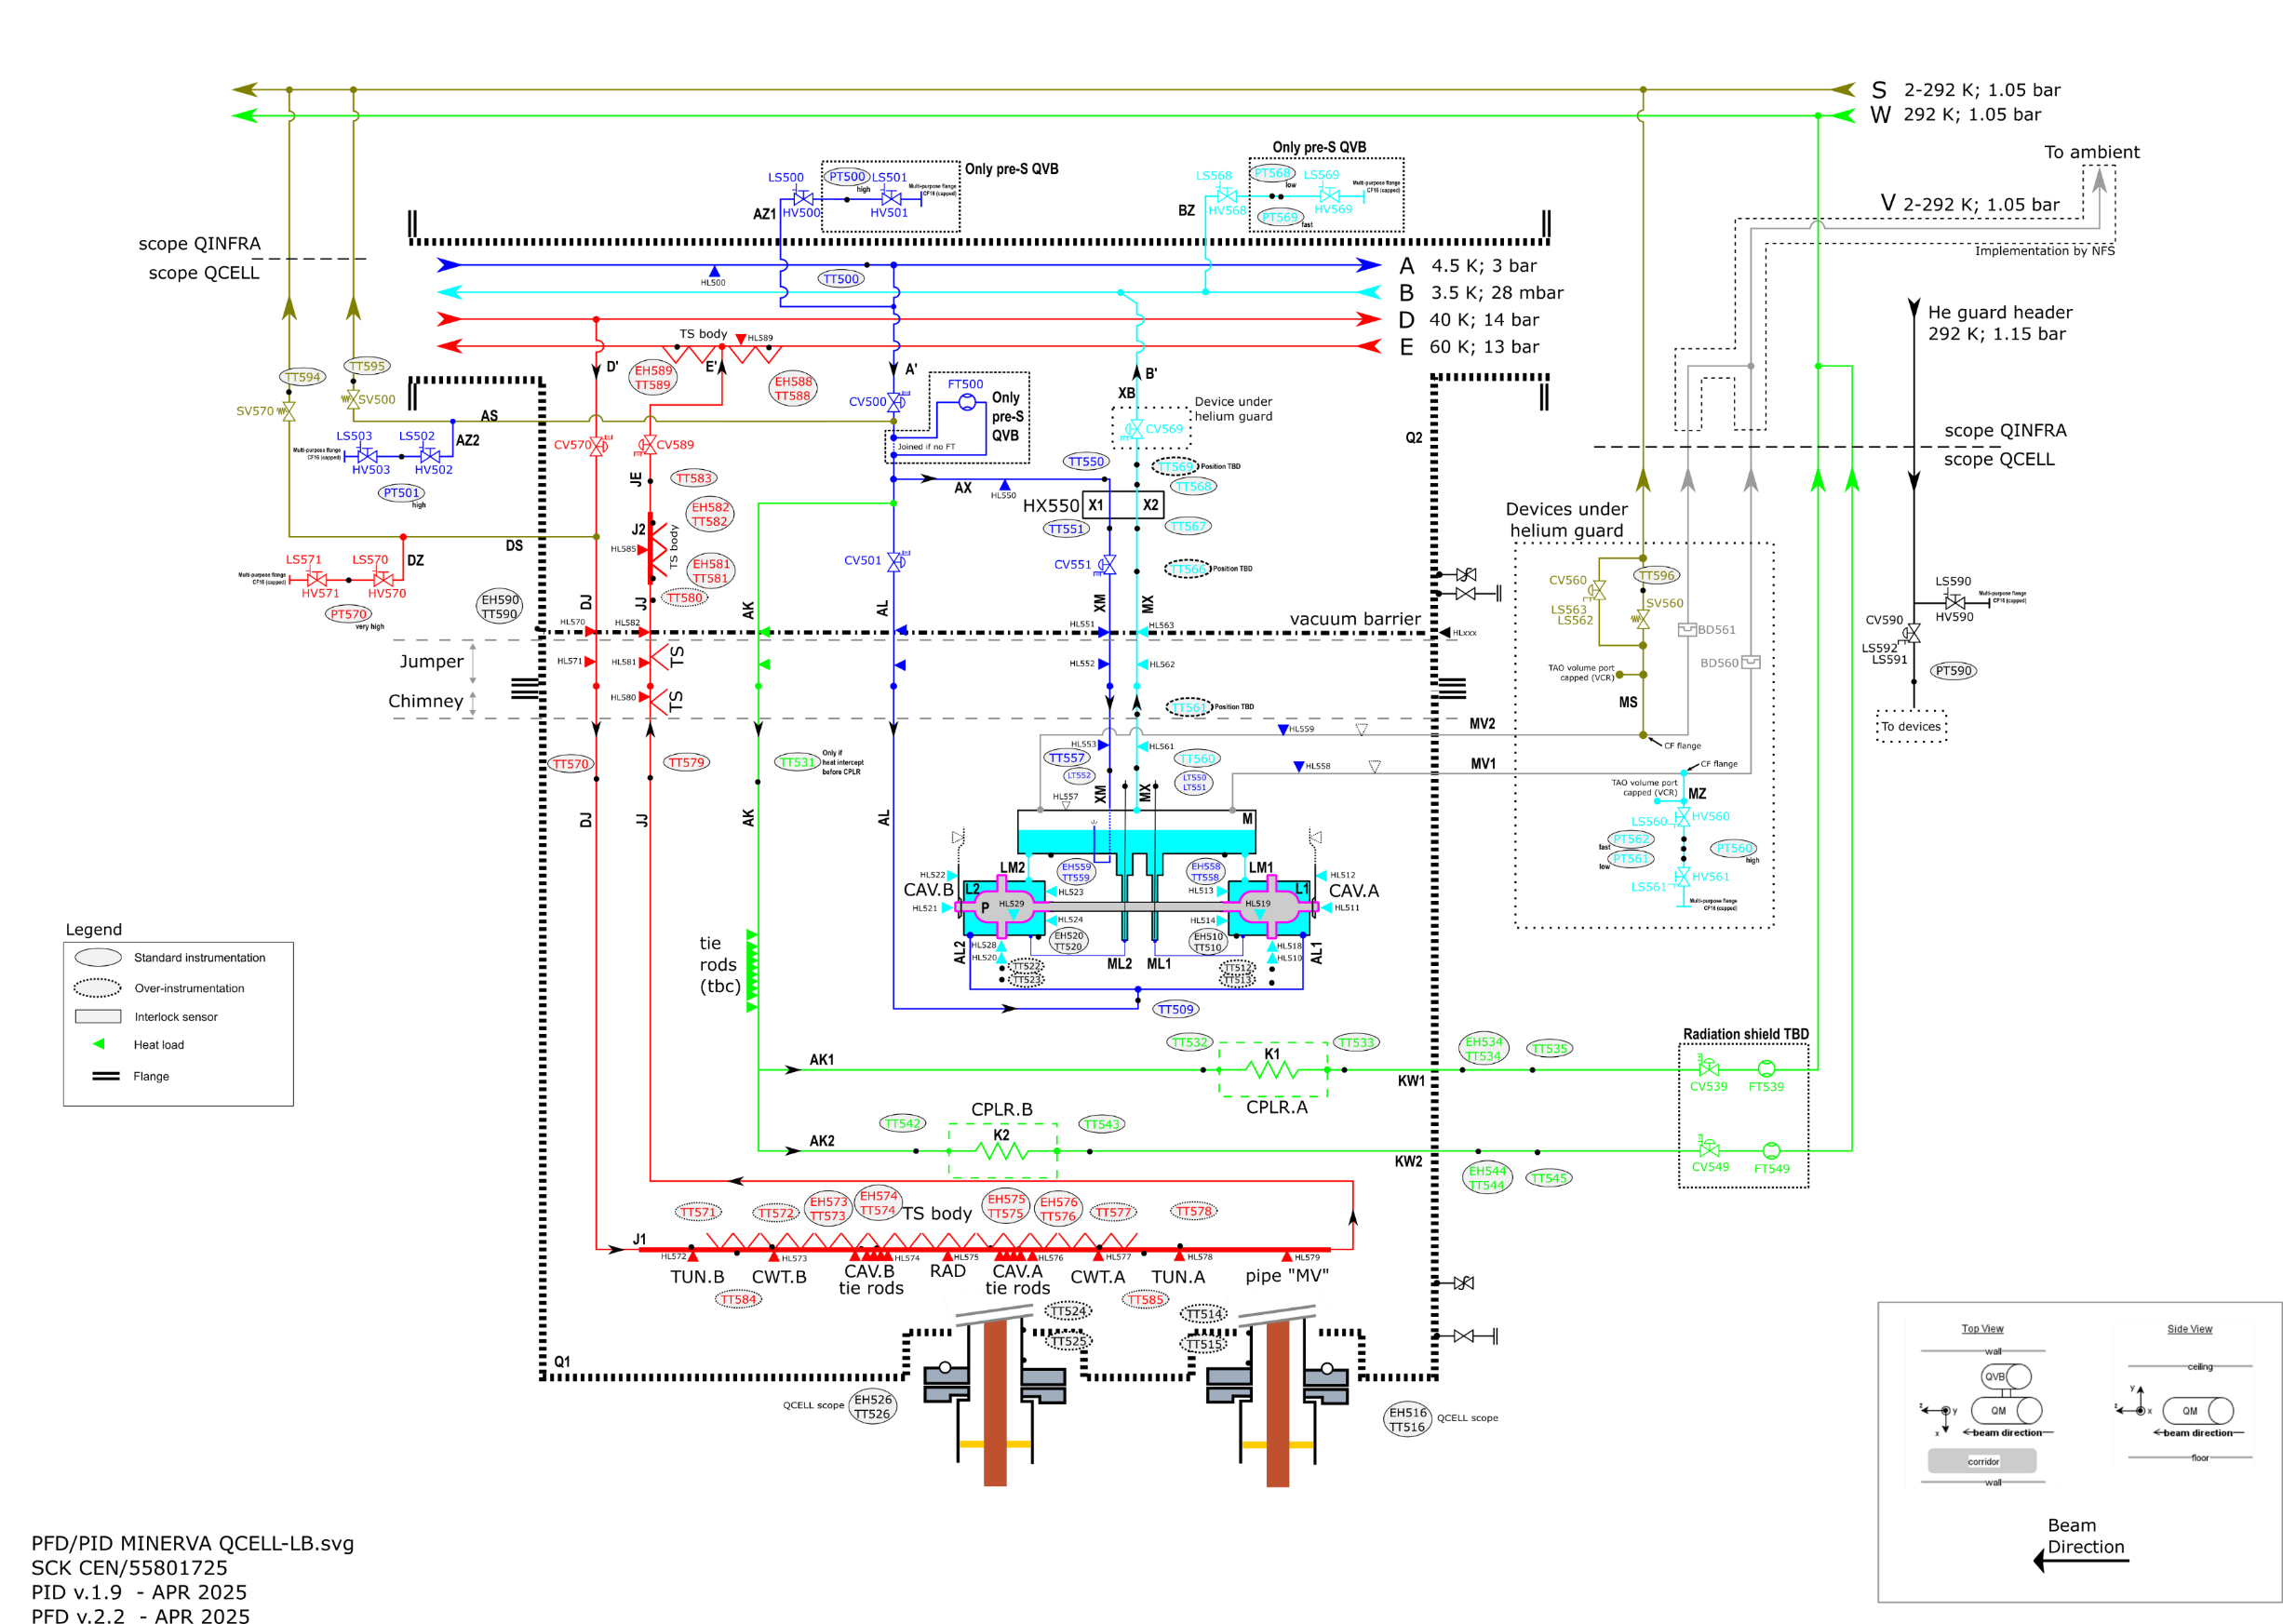
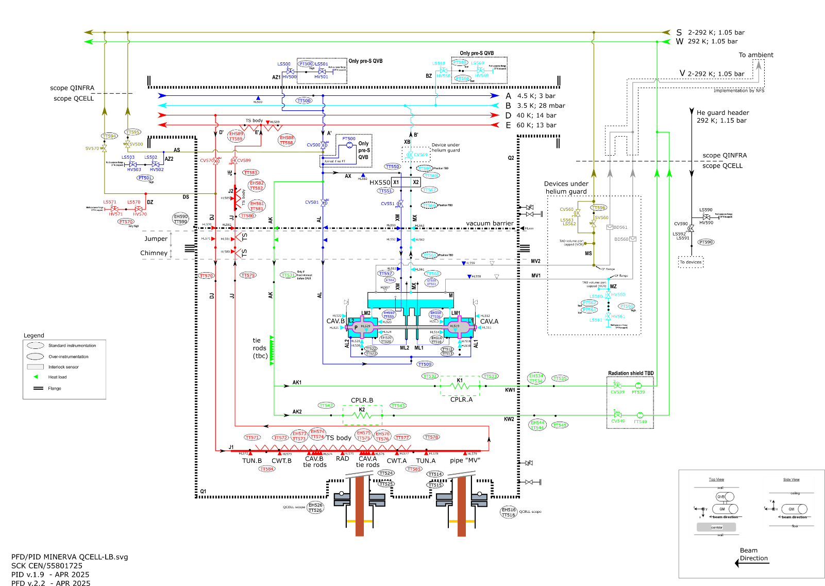
QCELL’s Flow Diagram

